Slide 1
DIPLOMADO EN INTRODUCCIÓN A LA CIENCIA DE DATOS
Deep Learning
Luis Alejandro Torres Niño

Slide 2
Qué es Deep Learning?

Slide 3
Deep Learning
Traditional programming
Building a Classifier
Define a set of rules for classification
1
Program those rules into the computer
2
Feed it examples, and the program uses the rules to classify
3

Slide 4
Deep Learning
Machine learning
Building a Classifier
Show model the examples with the answer of how to classify
1
Model takes guesses, we tell it if it’s right or not
2
Model learns to correctly categorize as it’s training. The system learns the rules on its own
3

Slide 5
Deep Learning
When to choose deep learning
Classic Programming
Deep Learning
If rules are clear and straightforward, often better to just program it
If rules are nuanced, complex, difficult to discern, use deep learning

Slide 6
Deep Learning
A Simpler Model

Slide 7



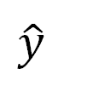
Deep Learning
A Simpler Model
$$y=mx+b$$
m•x
$$m= ?$$
x | y
1 | 3
2 | 5
$$b= ?$$
$$\hat{y}$$

Slide 8
Deep Learning
A Simpler Model
$$y=mx+b$$
m•x
$$m= ?$$
x | y
1 | 3
2 | 5
$$b= ?$$
$$\hat{y}$$

Slide 9
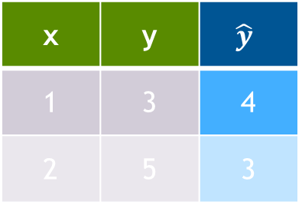



Deep Learning
A Simpler Model
$$y=mx+b$$
Start Random
m•x
x | y | $$\hat{y}$$
1 | 3 | 4
2 | 5 | 3
$$m=−1$$
$$b=5$$
$$\hat{y}$$

Slide 10
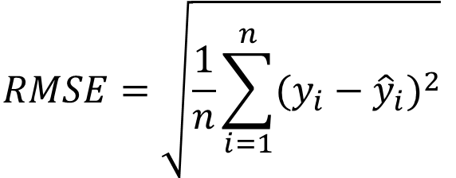

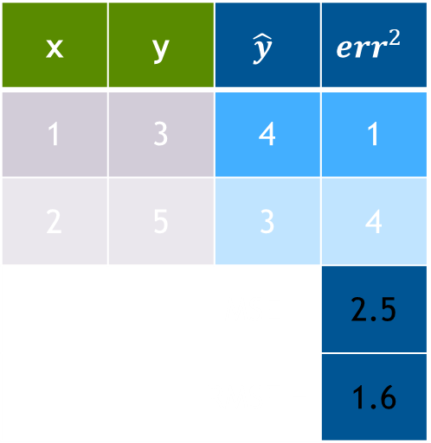

Deep Learning
A Simpler Model
$$y=mx+b$$
x | y | $$\hat{y}$$ | $${err}^{2}$$
1 | 3 | 4 | 1
2 | 5 | 3 | 4
MSE = |  |  | 2.5
RMSE = |  |  | 1.6
$MSE= \frac{1}{n}$ $\sum_{i=1}^{n}{{(y_{i}−{\hat{y}}_{i})}^{2}}$
$$RMSE=\sqrt{\frac{1}{n}\sum_{i=1}^{n}{{(y_{i}−{\hat{y}}_{i})}^{2}}}$$

Slide 11
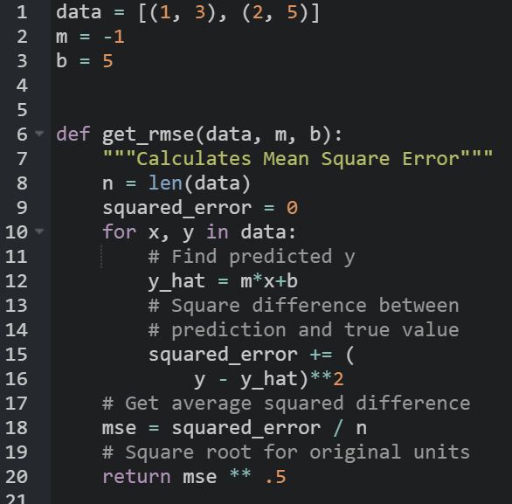


Deep Learning
A Simpler Model
$$y=mx+b$$
x | y | $$\hat{y}$$ | $${err}^{2}$$
1 | 3 | 4 | 1
2 | 5 | 3 | 4
MSE = |  |  | 2.5
RMSE = |  |  | 1.6

Slide 12
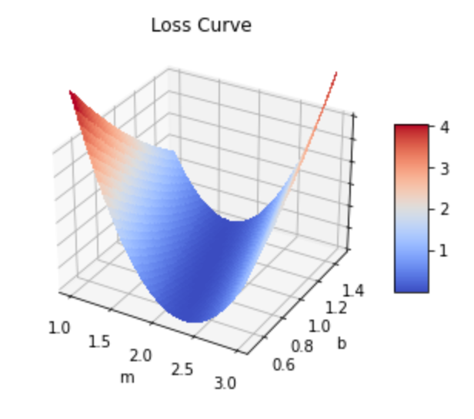
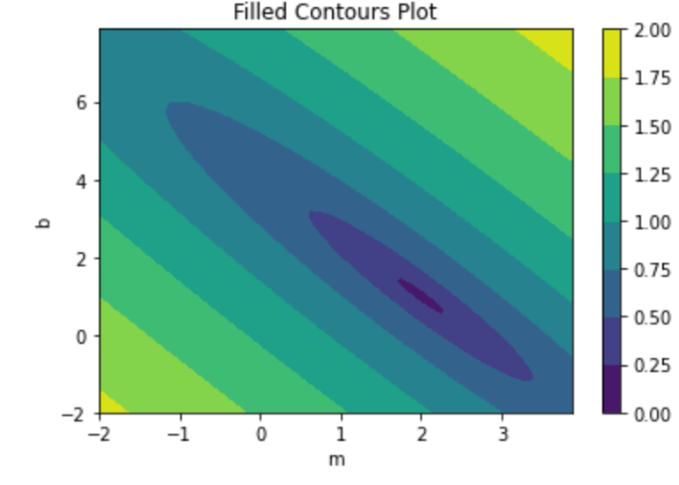
Deep Learning
The Loss Curve
Loss Surface
16
0
MSE
MSE

Slide 13


Deep Learning
The Loss Curve
16
0
Current
MSE
Target
$$m=−1$$
$$b=5$$

Slide 14

Deep Learning
The Loss Curve
16
0
Old
Current
MSE
Target
$$m=−1$$
$$b=4$$

Slide 15


Deep Learning
The Loss Curve
16
0
Current
MSE
Target
$$m=0$$
$$b=4$$

Slide 16
Deep Learning
The Loss Curve
The Gradient
Which direction loss decreases the most
$λ$: The learning rate
λ: The learning rate
How far to travel
Epoch
A model update with the full dataset
Batch
A sample of the full dataset
Step
An update to the weight parameters
16
0
16
0
MSE
Target

Slide 17
Deep Learning
The Loss Curve
The Gradient
Which direction loss decreases the most
$λ$: The learning rate
λ: The learning rate
How far to travel
Epoch
A model update with the full dataset
Batch
A sample of the full dataset
Step
An update to the weight parameters
16
0
MSE
Target

Slide 18

Deep Learning
Optimizers
Loss – Momentum Optimizer
Adam
Adagrad
RMSprop
SGD

Slide 19
Deep Learning
FROM NEURON TO NETWORK

Slide 20
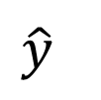
Deep Learning
Building a Network
Scales to more inputs
w₁
w₂
$$\hat{y}$$

Slide 21
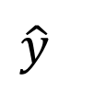
Deep Learning
Building a Network
x₁
x₂
w₂
w₃
Scales to more inputs
Can chain neurons
w₁
w₄
w₅
w₆
$$\hat{y}$$

Slide 22

Deep Learning
Building a Network
x₁
x₂
w₂
w₃
Scales to more inputs
Can chain neurons
If all regressions are linear, then output will also be a linear regression
w₁
w₄
w₅
w₆
$$\hat{y}$$

Slide 23
Deep Learning
Activation Functions

Slide 24
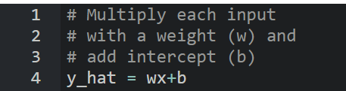

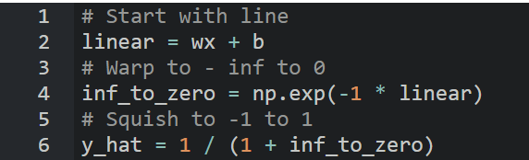
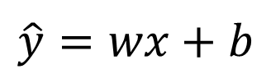

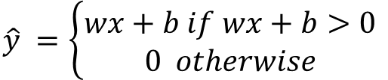
Deep Learning
Activation Functions
Linear
ReLU
Sigmoid
$$\hat{y}=wx+b$$
$$\hat{y} =\left\{\begin{aligned}wx+b if wx+b>0 \\ 0 otherwise\end{aligned}\right.$$
$$\hat{y} =\frac{1}{1+e^{−(wx+b)}}$$

Slide 25


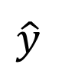



Deep Learning
Activation Functions
x₁
w₁
w₂
w₃
w₄
$$\hat{y}$$

Slide 26
Deep Learning
First exercise: Classify handwritten digits

Slide 27
Deep Learning
Hello Neural Networks
Train a network to correctly classify handwritten digits
Historically important and difficult task for computers
Try learning like a Neural Network
Get exposed to the example, and try to figure out the rules to how it works

Slide 28

Deep Learning
Data preparation
Input as an array
28
[0,0,0,24,75,184,185,78,32,55,0,0,0…]
28

Slide 29
Deep Learning
Data preparation
Targets as categories
0
[1,0,0,0,0,0,0,0,0,0]
1
[0,1,0,0,0,0,0,0,0,0]
2
[0,0,1,0,0,0,0,0,0,0]
3
[0,0,0,1,0,0,0,0,0,0]
.
.
.

Slide 30
Deep Learning
An untrained model
[ 0, 0, …, 0]
(784,)
… … …
(512,)
Layer
Size
… … …
(512,)
(10,)

